Slide 1


BANGALORE INSTITUTE OF TECHNOLOGY
DEPARTMENT OF ELECTRONICS AND COMMUNICATION ENGINEERING
SMART TRAFFIC CONTROL SYSTEM
FOR EMERGENCY VEHICLES
Under the guidance of:
Presented by:
Radha B L
Associate Professor
Dept. of ECE
BIT, Bangalore
H P Jeevan - 1BI18EC051
G Rohith - 1BI18EC045
Emyl Varghese George - 1BI18EC044

Slide 2
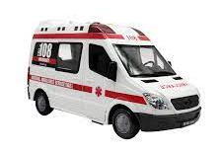
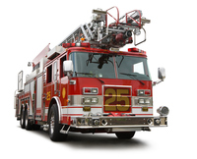
ABSTRACT
Due to ever-increasing population, vehicles are becoming omnipresent, especially in major cities around. the world. Emergency vehicles, like ambulances and fire trucks, are the most affected ones due to traffic problems, as lives could be at stake.
Unfortunately, due to delay of emergency vehicles there is up to 20% increase of deaths caused mainly due to traffic jams
The aim of this project is to develop a Smart traffic control system for emergency vehicles to facilitate smooth passage of emergency vehicle at traffic signals.
Figure 1 Emergency Vehicles
Date: 22-07-2022 | SMART TRAFFIC CONTROL SYSTEM FOR EMERGENCY VEHICLES | Slide No: 2

Slide 3
CONTENTS
Sl.no | Topic | Slide no.
1. | Introduction | 4
2. | Aim and Objectives | 5
2. | Literature Survey | 6
3. | Methodology | 7
4. | Implementation and Design | 8
5. | Results | 24
6. | Conclusion | 29
7. | References | 30
Date: 22-07-2022 | SMART TRAFFIC CONTROL SYSTEM FOR EMERGENCY VEHICLES | Slide No: 3

Slide 4
INTRODUCTION
Emergency vehicles play an important role in every life-threatening situation. In today’s world, it is observed that there is a steady rise in traffic due to increased use of personal vehicles.
The purpose of this project is to develop an automated solution based on siren detection to add to the currently existing traffic system that gives preference to emergency vehicles.
To assist with the detection of sirens, it is important to understand the soundscape of traffic. This soundscape can be roughly separated into three sub-sources of sounds, including siren sounds, vehicle horns generated by ordinary vehicles, and noises.
This project has two main regions of interest: detection of emergency vehicles and determining the direction of arrival.
Date: 22-07-2022 | SMART TRAFFIC CONTROL SYSTEM FOR EMERGENCY VEHICLES | Slide No: 4

Slide 5
AIM AND OBJECTIVES
Aim:
To design and implement a smart traffic control system for emergency vehicles.
Objectives:
To make a low-cost system that can be implemented in actual traffic signals.
To make an efficient detection system for emergency vehicle detection.
To reduce the delay for emergency vehicles.
To make an automated system that does not require constant maintenance.
Date: 22-07-2022 | SMART TRAFFIC CONTROL SYSTEM FOR EMERGENCY VEHICLES | Slide No: 5

Slide 6
LITERATURE SURVEY
A Study on Smart Regulation of Emergency Vehicles by Ashwin Mohan, Anjitha R Nair, Anjali Anilkumar, Amal Suresh and Anish A Azi:
YOLO has been implemented to detect if an ambulance is present in the signal area. It then checks for the siren to see if the ambulance is in an emergency state. This sound detection process is done by the use of spectrograms.
Direction of arrival estimation – A two microphones approach by Carlos Fernández Scola and María Dolores Bolaños Ortega:
Two microphones are used to determine the direction in which sound is arriving in this paper. This is done by the use of autocorrelation .
Design and Implementation of Butterworth, Chebyshev-I and Elliptic Filter for Speech Signal Analysis by Prajoy Podder, Md. Mehedi Hasan, Md.Rafiqul Islam and Mursalin Sayeed:
This paper discusses the types of filters and the noise suppression each filter provides. Chebyshev Filters are selected for this project.
Date: 22-07-2022 | SMART TRAFFIC CONTROL SYSTEM FOR EMERGENCY VEHICLES | Slide No: 6

Slide 7
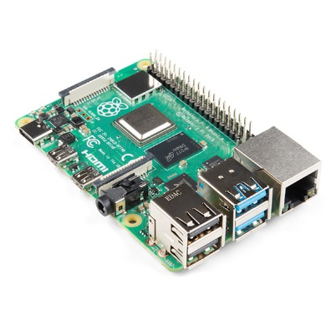
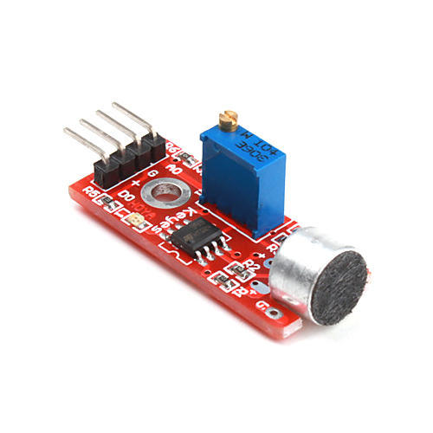
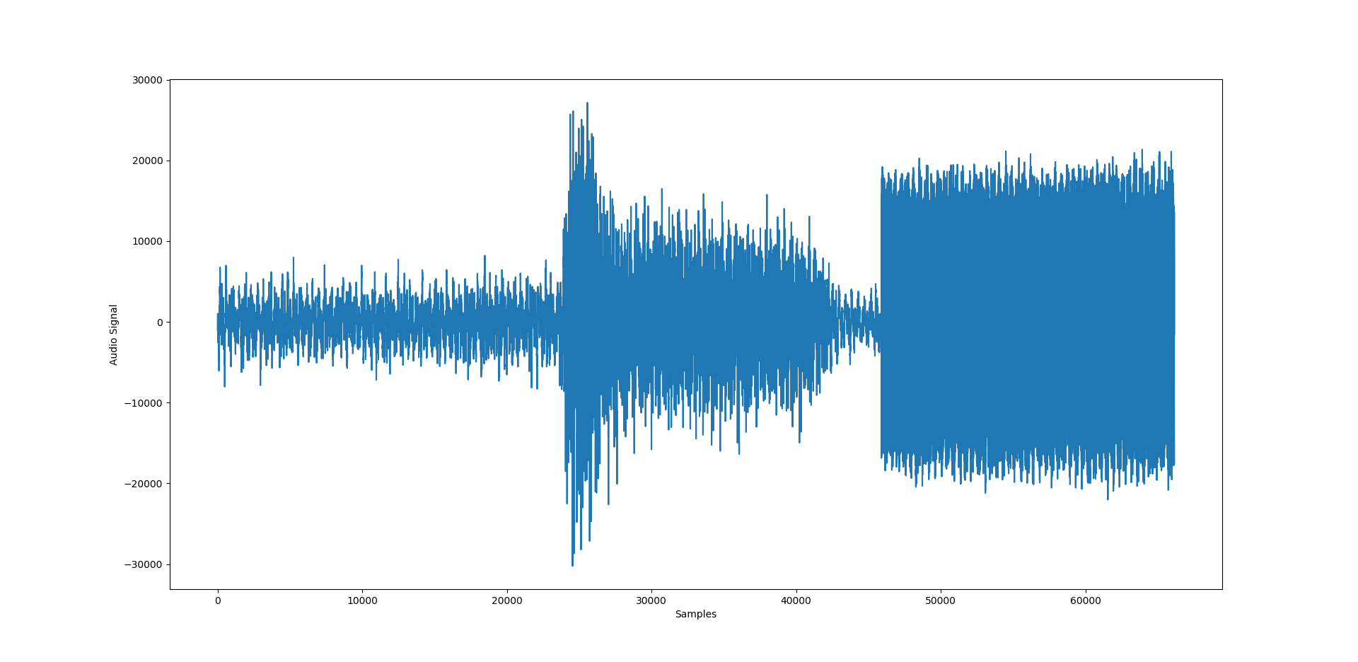

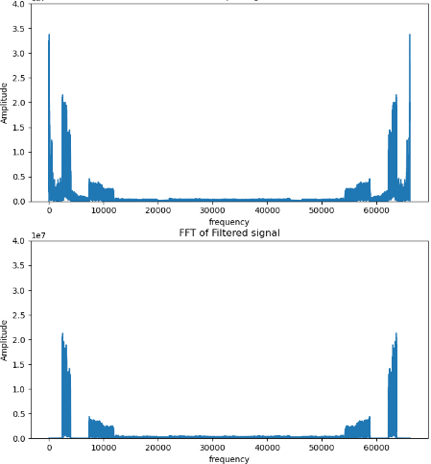
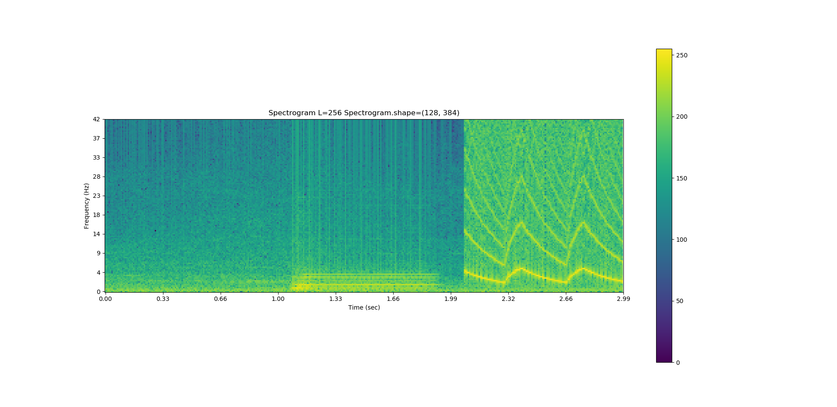
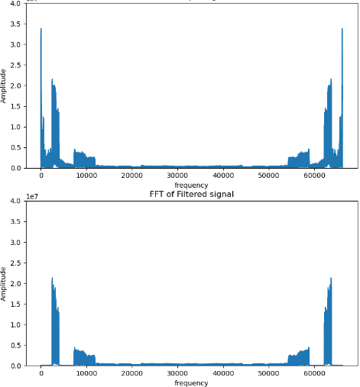
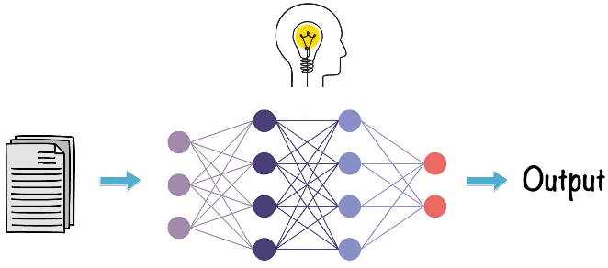
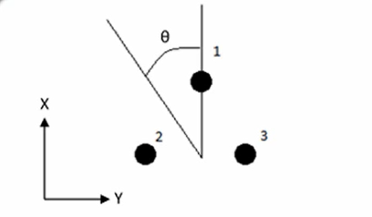
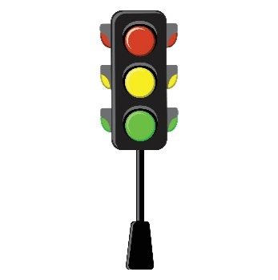
METHODOLOGY
Raspberry Pi
Spectrogram
Neural Network model
Filter
Direction of emergency vehicle
Traffic control
Figure 2 Block diagram of the system built
Date: 22-07-2022 | SMART TRAFFIC CONTROL SYSTEM FOR EMERGENCY VEHICLES | Slide No: 7

Slide 8
IMPLEMENTATION AND DESIGN
Data acquisition and pre-processing
Three types of audio samples are collected, siren signals of emergency vehicles, background traffic noise and other vehicle horns.
Each audio signal is sampled at the rate of 22050Hz. Each data point of the audio is converted to 16-bit integer.
Three seconds of each audio signals are considered and are combined to form 5 different classes of data.
These are again classified into 2 types; one containing the siren signal of emergency vehicle and other without the siren signal.
Date: 22-07-2022 | SMART TRAFFIC CONTROL SYSTEM FOR EMERGENCY VEHICLES | Slide No: 8

Slide 9
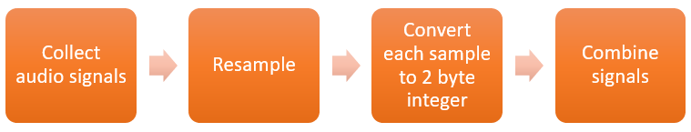
IMPLEMENTATION AND DESIGN
Synthetic dataset generation
Sirens typically occupy the frequency bands 820Hz to 1320Hz and 2470Hz to 3950Hz.
Each signal is sampled based on Nyquist criteria, F_{s} ≥ 2 * F_{max}
The spectrograms are generated for 3000 audio signals and stored as 128pixel X 384pixel images.
These images are divided into train, validate and test in the ratio 75%, 15% and 10%.
Figure 3 Data acquisition and cleaning
Date: 22-07-2022 | SMART TRAFFIC CONTROL SYSTEM FOR EMERGENCY VEHICLES | Slide No: 8

Slide 10
IMPLEMENTATION AND DESIGN
Spectrogram: A spectrogram is a visual representation of the spectrum of frequencies of a signal as it varies with time.
The x-axis represents the time, y-axis represents the frequency and color represents the amplitude of the each frequency.
Figure 4 Audio signal
Figure 5 Spectrogram
Date: 22-07-2022 | SMART TRAFFIC CONTROL SYSTEM FOR EMERGENCY VEHICLES | Slide No: 10

Slide 11
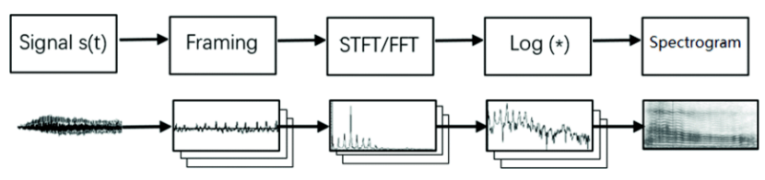
IMPLEMENTATION AND DESIGN
Framing: The audio signal in the time domain is broken down into chunks of the same length.
FFT: An N-point FFT is performed on each of these frames.
Log (*): Element-wise log operation
Stacking: Each spectrum is stacked side by side to form the spectrogram.
Figure 6 Steps for spectrogram generation
Date: 22-07-2022 | SMART TRAFFIC CONTROL SYSTEM FOR EMERGENCY VEHICLES | Slide No: 11

Slide 12
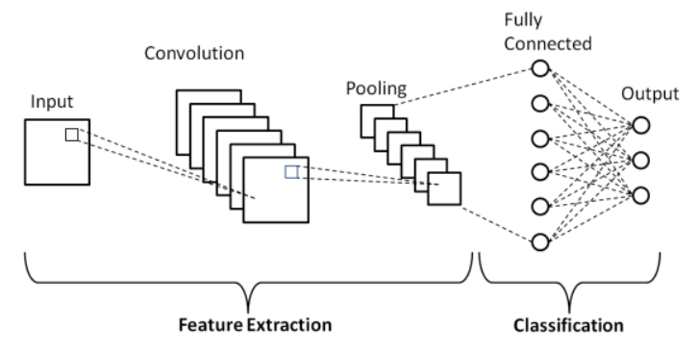
IMPLEMENTATION AND DESIGN
Convolution Neural network
A Convolutional Neural Network(CNN) is a type of deep neural network used in image recognition and classification that is specifically designed to process pixel data.
The network consist of 3 types of layers: Convolution layer, Pooling layer and fully-connected layer.
Figure 7 Convolutional neural network layers
Date: 22-07-2022 | SMART TRAFFIC CONTROL SYSTEM FOR EMERGENCY VEHICLES | Slide No: 12

Slide 13
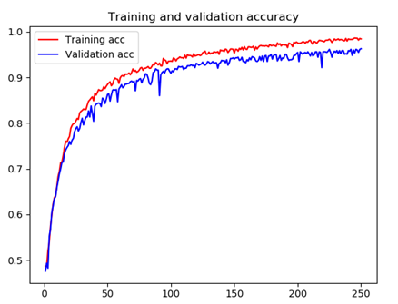
IMPLEMENTATION AND DESIGN
Figure 8 CNN Architecture
Figure 9 Training and validation accuracy
Date: 22-07-2022 | SMART TRAFFIC CONTROL SYSTEM FOR EMERGENCY VEHICLES | Slide No: 13

Slide 14
IMPLEMENTATION AND DESIGN
Filter
Filtering is a process that reduces the noise in the signal.
Removing the noise from the siren is important to get the autocorrelation and direction of the siren precisely.
Siren sounds contain only two bands of frequencies. Therefore, two bandpass filters can be used to get the two frequency bands.
The filter is designed using Filter Designer app of MATLAB.
The frequency ranges of interest are: 820-1320Hz and 2470-3950Hz
We design two Chebyshev Type-1 bandpass filters
Band pass filter 1 – F_{LP} = 820Hz, F_{LS} = 770Hz, F_{HP} = 1320Hz, F_{HS} = 1350Hz
Band pass filter 2 - F_{LP} = 2470Hz, F_{LS} = 2440Hz, F_{HP} = 3950Hz, F_{HS} = 4000Hz
Date: 22-07-2022 | SMART TRAFFIC CONTROL SYSTEM FOR EMERGENCY VEHICLES | Slide No: 14

Slide 15
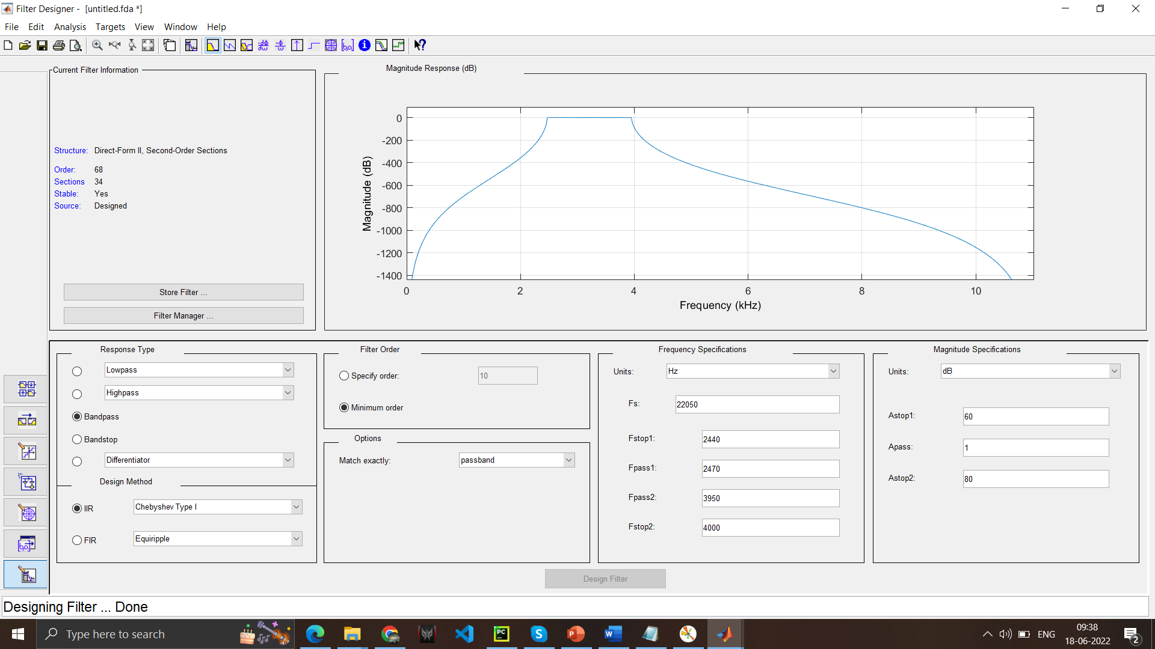
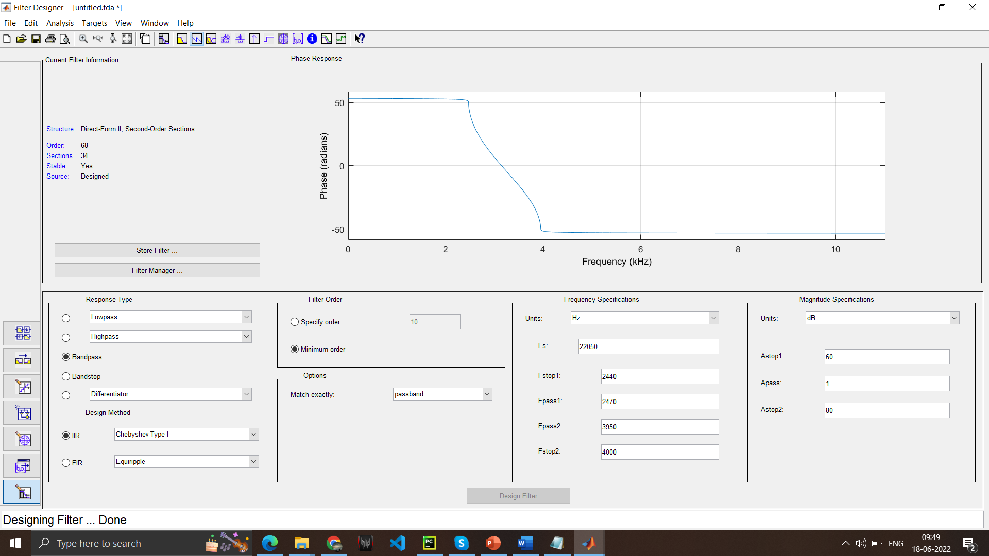
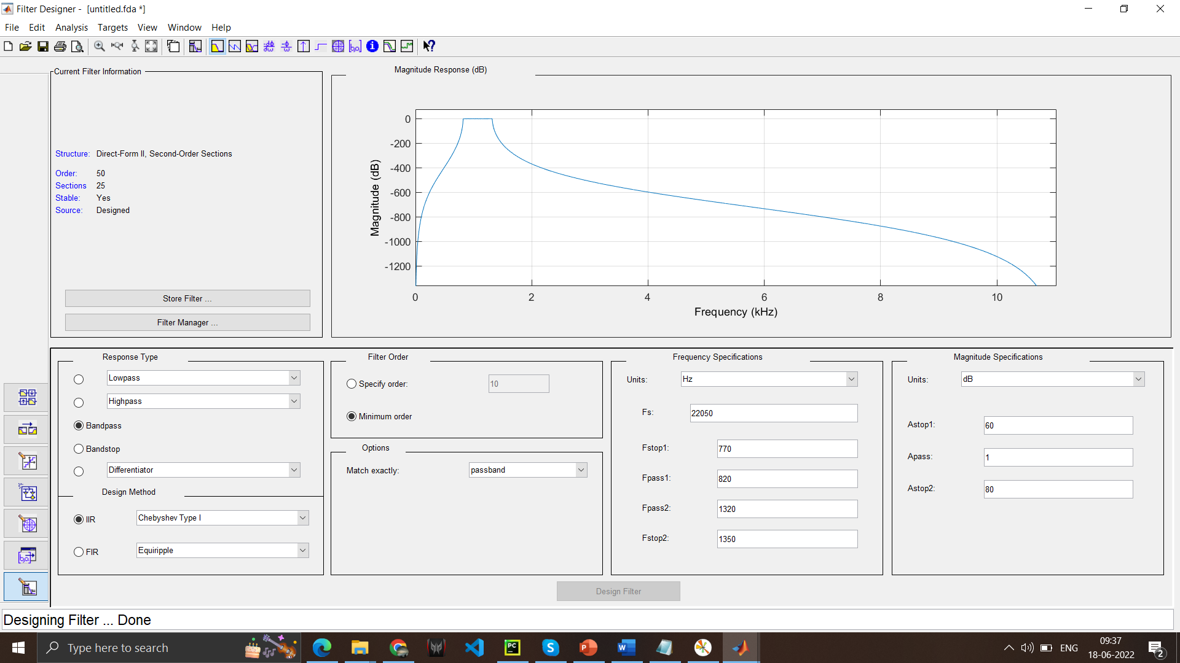
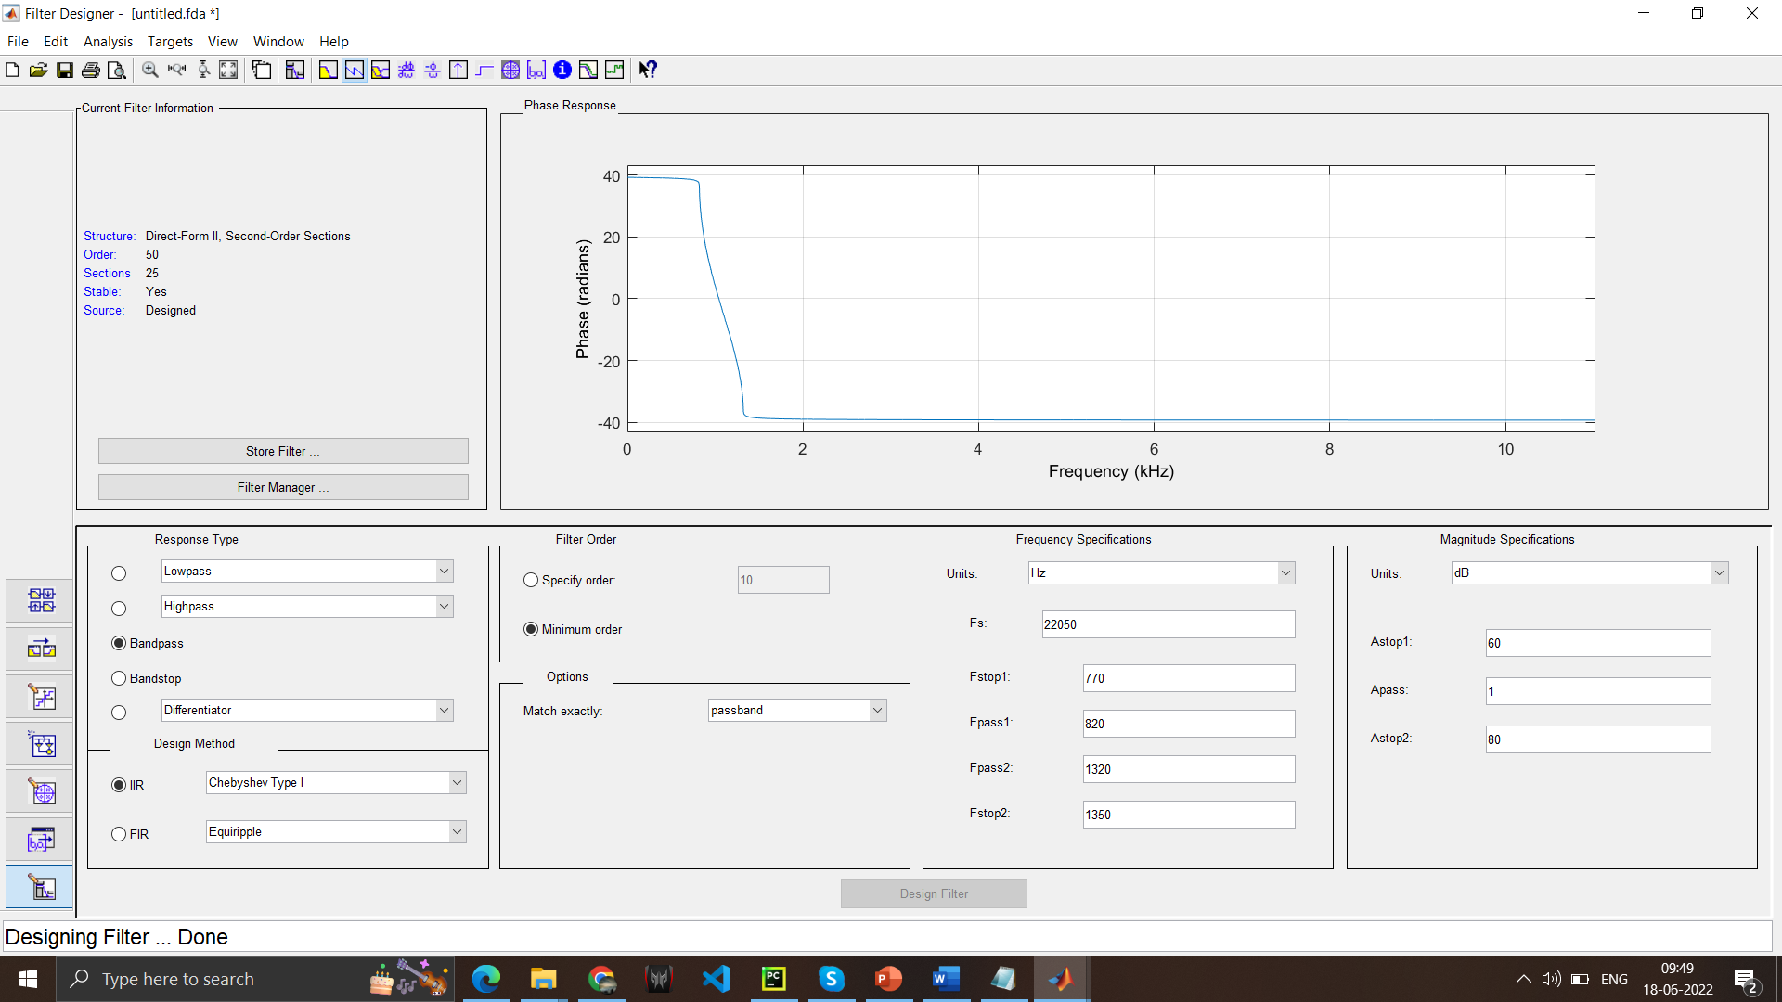
IMPLEMENTATION AND DESIGN
(a)
(b)
(c)
(d)
Figure 10 a) Magnitude response of Bandpass filter I b) Phase response of Bandpass filter I
c)Magnitude response of Bandpass filter II d) Phase response of Bandpass filter II
Date: 22-07-2022 | SMART TRAFFIC CONTROL SYSTEM FOR EMERGENCY VEHICLES | Slide No: 15

Slide 16
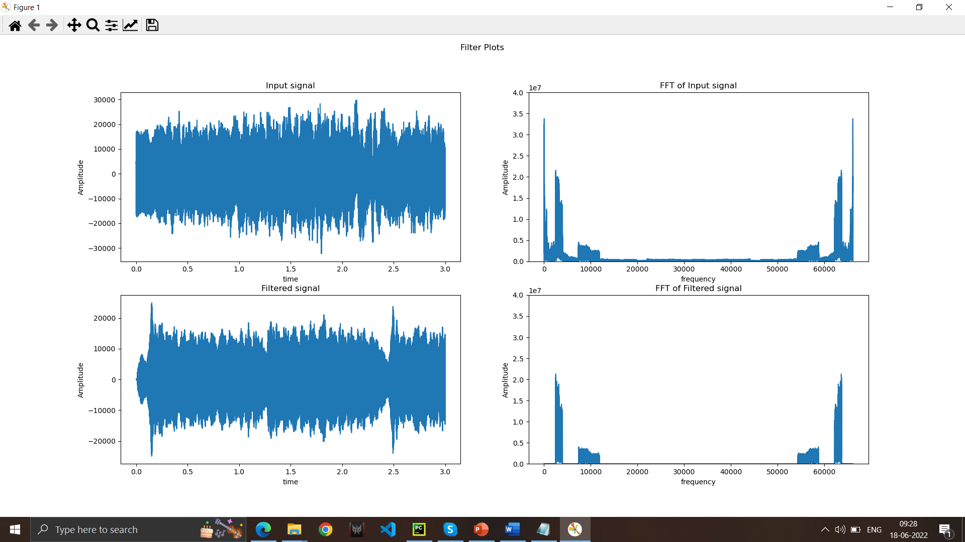
IMPLEMENTATION AND DESIGN
(a)
(b)
(c)
(d)
Figure 11 Filter design: a) Input signal b) FFT of the input signal c) Filtered signal and d) FFT of the filtered signal
Date: 22-07-2022 | SMART TRAFFIC CONTROL SYSTEM FOR EMERGENCY VEHICLES | Slide No: 16

Slide 17
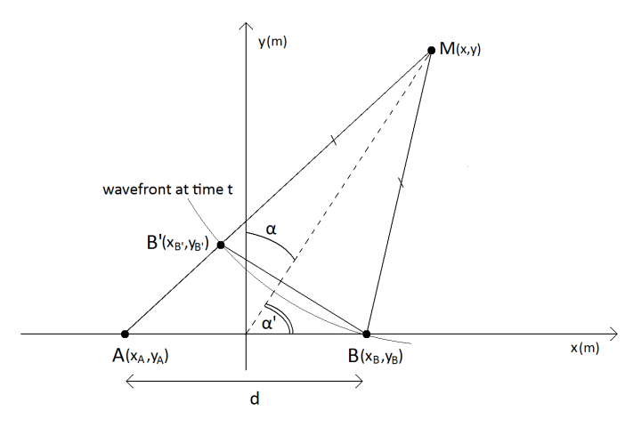
IMPLEMENTATION AND DESIGN
Direction of arrival estimation
Two microphones are placed at positions A and B at a distance d apart from each other.
Point M is the source of audio
α’ is the angle made by the audio source at the traffic junction.
Let B’ be the point at which the wavefront is the same as at Point B at any given time t on the line MA. This forms an isosceles triangle MBB’ where MB = MB’.
Figure 12 Diagram of the position of microphones and source
Date: 22-07-2022 | SMART TRAFFIC CONTROL SYSTEM FOR EMERGENCY VEHICLES | Slide No: 17

Slide 18
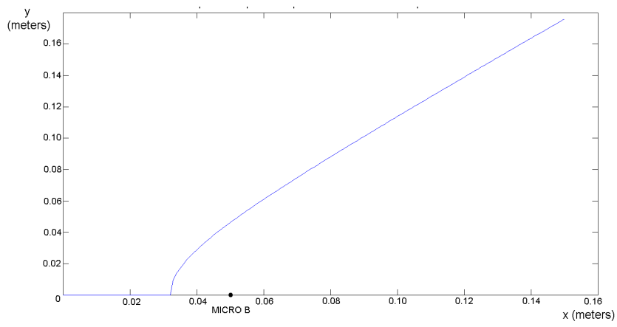
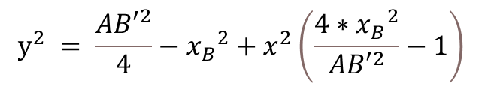

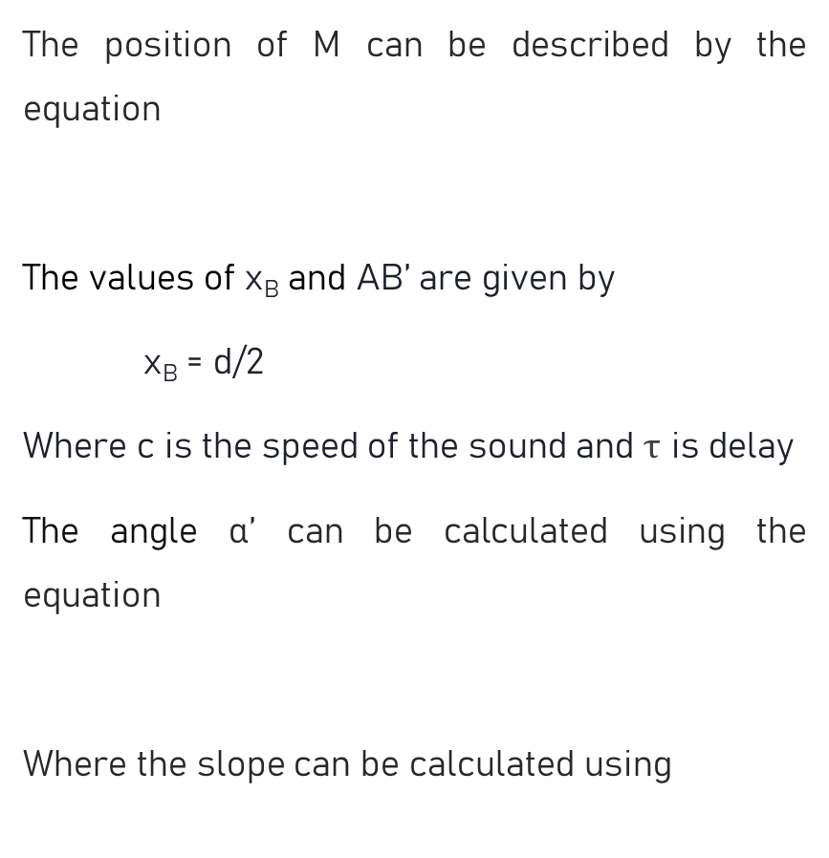
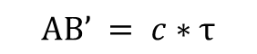

IMPLEMENTATION AND DESIGN
The position of M can be described by the equation
The values of x_{B} and AB’ are given by
x_{B} = d/2
Where c is the speed of the sound and $τ$ is delay
The angle α’ can be calculated using the equation
Where the slope can be calculated using
$$y^{2} = \frac{{AB′}^{2}}{4}−{x_{B}}^{2}+x^{2}\left(\frac{4∗{x_{B}}^{2}}{{AB′}^{2}}−1\right)$$
$$AB’ = c∗τ$$
$$α’= \tan^{−1}\left(\frac{dy}{dx}\right)$$
$$\frac{dy}{dx}=\frac{y_{2}− y_{1} }{x_{2}−x_{1}}$$
Figure 13 Possible x and y values for given AB’ and x_{B} values
Date: 22-07-2022 | SMART TRAFFIC CONTROL SYSTEM FOR EMERGENCY VEHICLES | Slide No: 18

Slide 19
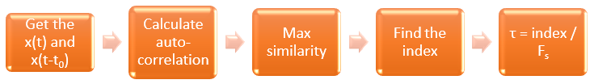
IMPLEMENTATION AND DESIGN
Delay calculation
Delay (τ) between audio signals received from the microphones can be calculated using auto correlation
Autocorrelation is a mathematical representation of the degree of similarity between a given time series and a time shifted version of the signal. The time delay is calculated using the index of max similarity and sampling frequency
τ = Lag_index / F_{s}
Figure 14 Procedure to calculate the delay
Date: 22-07-2022 | SMART TRAFFIC CONTROL SYSTEM FOR EMERGENCY VEHICLES | Slide No: 19

Slide 20
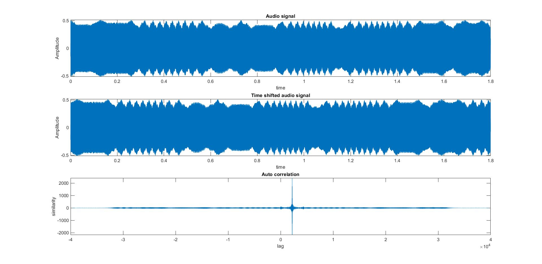
IMPLEMENTATION AND DESIGN
(a)
(b)
(c)
Figure 15 a) Audio signal, b) Time-shifted signal, and c) Autocorrelation of the two signals
Date: 22-07-2022 | SMART TRAFFIC CONTROL SYSTEM FOR EMERGENCY VEHICLES | Slide No: 20

Slide 21
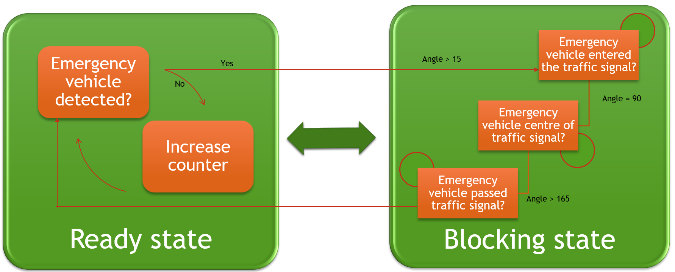
IMPLEMENTATION AND DESIGN
Traffic Control
Figure 16 FSM of traffic system
Date: 22-07-2022 | SMART TRAFFIC CONTROL SYSTEM FOR EMERGENCY VEHICLES | Slide No: 21

Slide 22
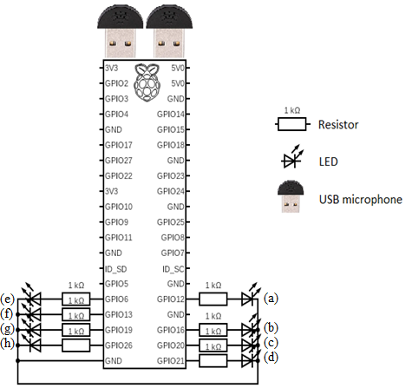
IMPLEMENTATION AND DESIGN
Connections
Pin no. | LED no.
12 | (a)
16 | (b)
20 | (c)
21 | (d)
6 | (e)
13 | (f)
19 | (g)
26 | (h)
Figure 17 Connections to Raspberry Pi
Date: 22-07-2022 | SMART TRAFFIC CONTROL SYSTEM FOR EMERGENCY VEHICLES | Slide No: 22

Slide 23
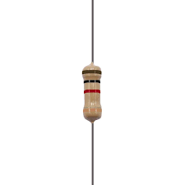
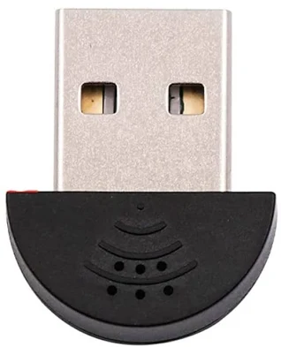





IMPLEMENTATION AND DESIGN
Hardware Components:
Software:
Python
MATLAB – Filter designer
PuTTY, VNC viewer – SSH communication
(a)
(b)
(c)
(d)
Figure 18 Components a) Raspberry Pi 4 b) USB microphone c) LEDs and d) 1kΩ resistor
Date: 22-07-2022 | SMART TRAFFIC CONTROL SYSTEM FOR EMERGENCY VEHICLES | Slide No: 23

Slide 24
RESULTS
Direction of Siren
The neural network model built was tested on both spectrograms and continuous audio signals received from the microphone.
The model was tested on 300 randomly generated spectrograms (60% of signals with siren and 40% without siren sound)
The accuracy is calculated as
accuracy = (TP + TN)/ (TP + TN + FP + FN)
accuracy = (172+119) / 300 = 0.97 or 97%
 | Predicted NO | Predicted YES
Actual NO | 119 (TN) | 1 (FP)
Actual YES | 8 (FN) | 172 (TP)
Date: 22-07-2022 | SMART TRAFFIC CONTROL SYSTEM FOR EMERGENCY VEHICLES | Slide No: 24

Slide 25
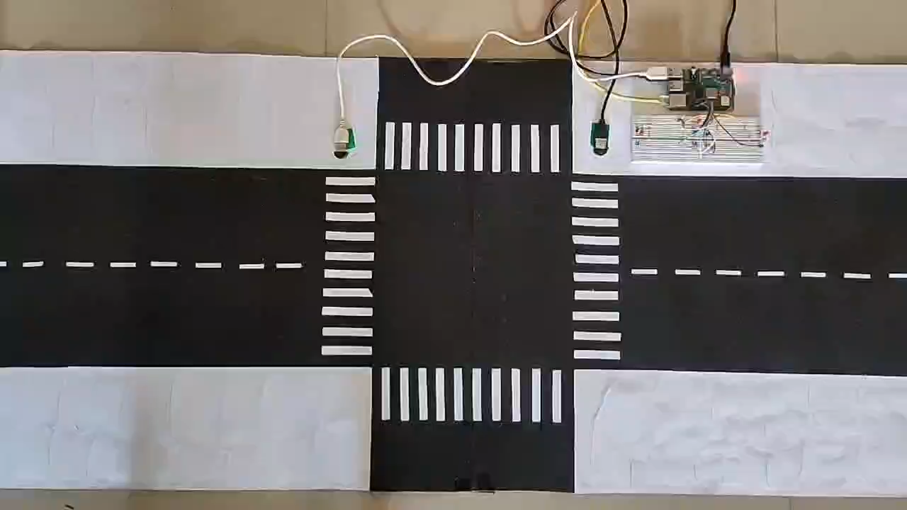
RESULTS
Date: 22-07-2022 | SMART TRAFFIC CONTROL SYSTEM FOR EMERGENCY VEHICLES | Slide No: 25

Slide 26
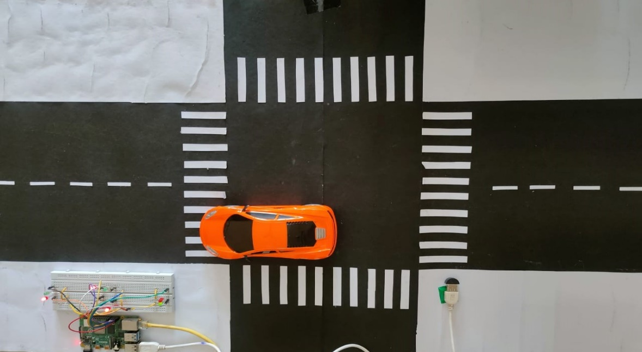
RESULTS
Model on one-dimensional road
Figure 19 Model used for the case of one-dimensional road
 | Detection time (sec) | Execution time (sec) | Time for which emergency vehicle is at the traffic signal (sec) | Success rate (%)
Average | 29.32 | 57.42 | 28.11 | 88
Standard deviation | 7.75 | 14.73 | 10.53 | -
Date: 22-07-2022 | SMART TRAFFIC CONTROL SYSTEM FOR EMERGENCY VEHICLES | Slide No: 26

Slide 27
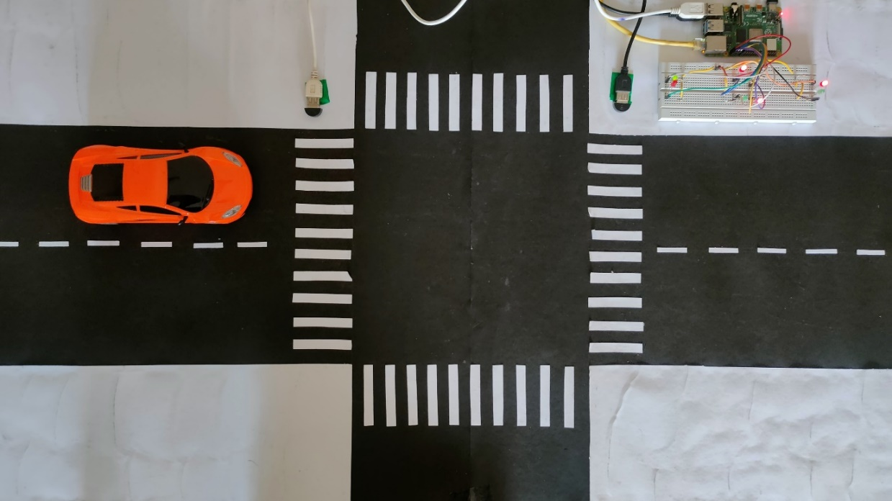
RESULTS
Model on one-dimensional road with the direction of arrival
Figure 20 Model used for the case of the one-dimensional road with angle calculation
 | Detection time (sec) | Execution time (sec) | Time for which emergency vehicle is at the traffic signal (sec) | Success rate (%)
Average | 36.94 | 66.38 | 30.06 | 84
Standard deviation | 8.84 | 13.43 | 11.61 | -
Date: 22-07-2022 | SMART TRAFFIC CONTROL SYSTEM FOR EMERGENCY VEHICLES | Slide No: 27

Slide 28
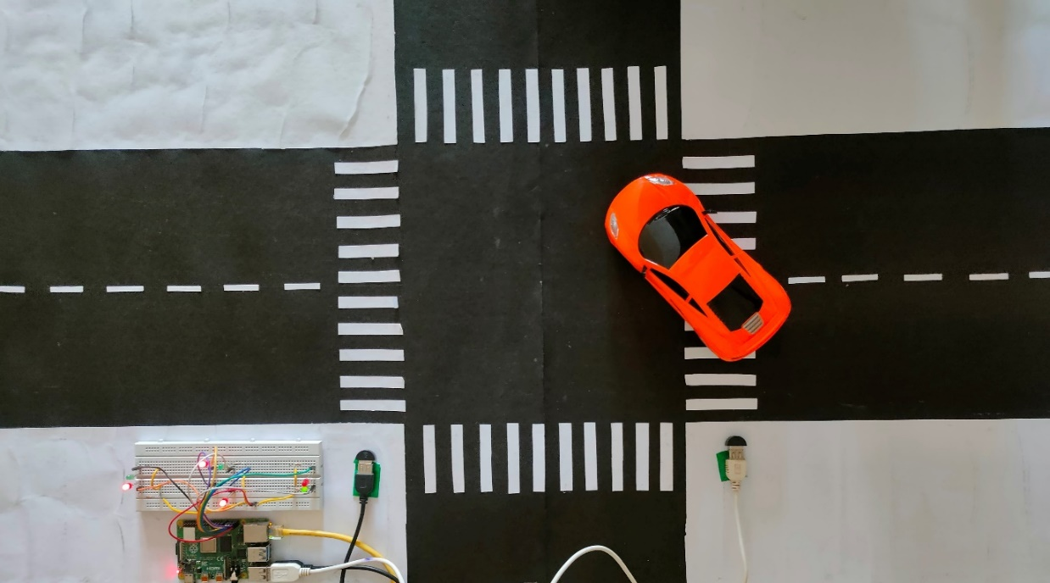
RESULTS
Model on T-type traffic signal with the direction of arrival
Figure 21 Model used for the case of T-type traffic signal with angle calculation
 | Detection time (sec) | Execution time (sec) | Time for which emergency vehicle is at the traffic signal (sec) | Success rate (%)
Average | 40.78 | 67.82 | 30.12 | 84
Standard deviation | 10.34 | 12.13 | 15.25 | -
Date: 22-07-2022 | SMART TRAFFIC CONTROL SYSTEM FOR EMERGENCY VEHICLES | Slide No: 28

Slide 29
CONCLUSION
Developed a low-cost and efficient system to detect emergency vehicles and control the traffic signal.
The model is computationally efficient with execution time of 67.82 seconds.
The complete model costs RS. 6000.
Future Scope
Implement the use of long-range microphones to improve the range of detection of the model.
To integrate the model on multiple traffic signals.
Advantages
The model is easy to set up in real world traffic signals.
The model is computationally efficient.
Requires low maintenance.
Date: 22-07-2022 | SMART TRAFFIC CONTROL SYSTEM FOR EMERGENCY VEHICLES | Slide No: 29

Slide 30
REFERENCES
[1] K Agrawal, M K Nigam, S Bhattacharya, and Sumathi G, “Ambulance detection using image processing and neural networks,” in Journal of Physics: Conference Series, 2115 012036, 2021.
[2] Ashwin Mohan, Anjitha R Nair, Anjali Anilkumar, Amal Suresh, and Anish A Aziz, “A Study on Smart Regulation of Emergency Vehicles,” in IJRASET, vol. 8, pp. 1010-1014, 2020.
[3] V. Tran and W. Tsai, "Acoustic-Based Emergency Vehicle Detection Using Convolutional Neural Networks," in IEEE Access, vol. 8, pp. 75702-75713, 2020.
[4] Roopashree V, Malavika D N, Nikitha Bai E, Suman A, Dr. Shashikala, “Traffic Congestion Detection and Alerting Ambulance using IoT,” in IJERT, vol. 09, 2020.
[5] Dr. Rajashree V. Biradar and Prashant, “Ambulance Rescue System with Traffic Control using IoT,” in IJESC, vol 9, pp. 21069-21072, 2019.
[6] Karthik B V, Manoj M, Rohit R Kowshik, Akash Aithal, and Dr. S. Kuzhalvai Mozhi, “Ambulance Detection and Traffic Control System,” in IRJET, vol. 6, pp. 1128-1134, 2019.
[7] Y. Huang, Y. Weng and M. Zhou, "Design of Traffic Safety Control Systems for Emergency Vehicle Preemption Using Timed Petri Nets," in IEEE Transactions on Intelligent Transportation Systems, vol. 16, pp. 2113-2120, 2015.
Date: 22-07-2022 | SMART TRAFFIC CONTROL SYSTEM FOR EMERGENCY VEHICLES | Slide No: 30

Slide 31
REFERENCES
[8] Scola, Carlos Fernández and María Dolores Bolaños Ortega. “Direction of arrival estimation: A two microphones approach,” in Master Thesis, Blekinge Institute of Technology, 2010
[9] Podder, Prajoy & Hasan, Md. Mehedi & Islam, Md & Sayeed, Mursalin, “Design and Implementation of Butterworth, Chebyshev-I and Elliptic Filter for Speech Signal Analysis,” 2020
[10] Bernard Gold, Dan Ellis, and Nelson Morgan, Speech and Audio Signal Processing: Processing and Perception of Speech and Music, John Wiley and Sons, 2011, Accessed on: 25 May 2022 [Online].
[11] Gerard Blanchet and Maurice Charbit, Digital Signal and Image Processing using Matlab, John Wiley and sons, 2006, Accessed on 12 April 2022 [Online].
[12] MATLAB. Estimating Direction of Arrival with MATLAB. (Oct 11, 2017). Accessed: May 25, 2022. [Online Video]. Available: https://www.youtube.com/watch?v=Sz_4jJKjPIQ&t=926s
[13] DrBennett. Cross-Correlation: time-delay estimation and matched filtering. (Jul 31, 2020). Accessed: Jun 5, 2022. [Online Video]. Available: https://www.youtube.com/watch?v=TS8HHW-HlGA&t=260s
Date: 22-07-2022 | SMART TRAFFIC CONTROL SYSTEM FOR EMERGENCY VEHICLES | Slide No: 31

Slide 32
THANK YOU

